Slide 1
Potential use of PE SCFT for the modeling of Nafion aggregates in water
Takashi Yokokura
04/27/2022

Slide 2
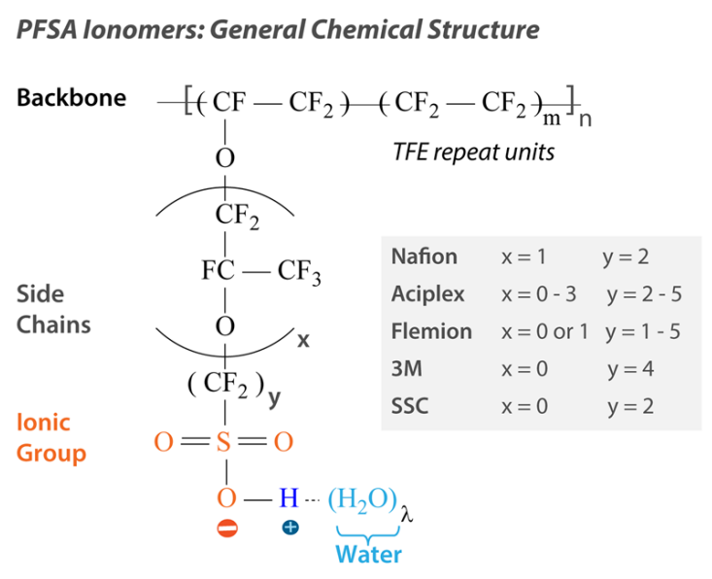
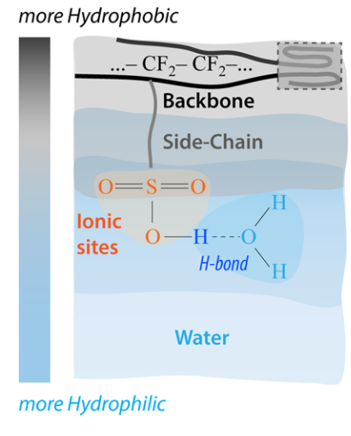
Overall chemical and physical picture
Figures: Kusoglu and Weber. Chem. Rev. 2017, 117, 987−1104

Slide 3
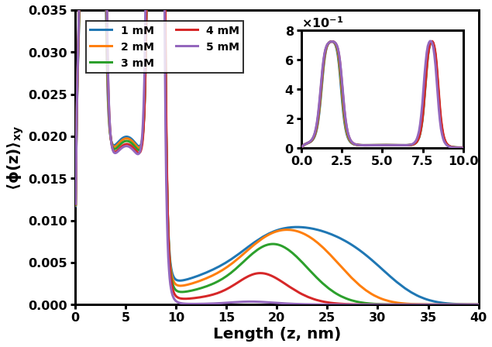
Theoretical Framework
Purpose: Accurately describe complex, coupled interactions within polyelectrolytes
Interactions:
Electrostatics (polymer, free ions)
Hydrophobicity (polymer, solvent)
Polymer elasticity
Local incompressibility (polymer, solvent)
Useful outputs:
Polymer, ion, solvent distribution profiles
Free energy

Slide 4

Applied to polymer brushes
Fix one end of the chain onto the surface, while the other is free
Chains must interact with surrounding chains (physically or electrostatically)
Coarse-grain chain into blocks
Important parameters:
Grafting density
Chain length and architecture
Flory-Huggins parameters of each block
Charge of each block
Block K
$$\{χ_{K},N_{K}, α_{K}\}$$
Block 2
Block 1

Slide 5
Steps for SCFT Derivation
Equations for each interaction are incorporated into a partition function over all states
Polymer conformations, number and locations of solvent molecules and ions
Mathematically transform partition function into a free energy
Functionally minimize free energy, leading to a system of equations that, when fully solved, describe the equilibrium state
“Useful outputs” from previous slide are contained within this system (e.g., polymer density profile)

Slide 6
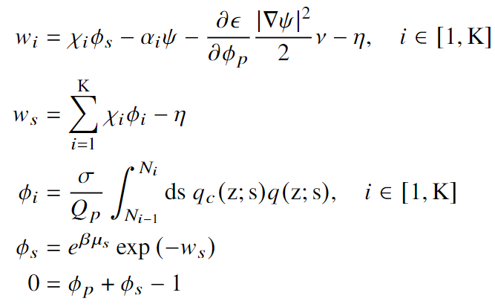
SCF Equations (1/2)
Polymer field
Solvent field
Polymer volume frac. profile
Solvent volume frac. profile
Incompressibility

Slide 7
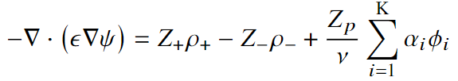

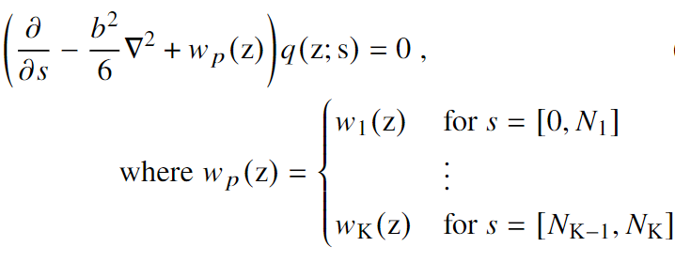
SCF Equations (2/2)
Electrostatics
Polymer elasticity and interaction fields

Slide 8
Potential application to Nafion dispersion
Degree of free hydrogen ions in solution is a function of Nafion aggregation
Within the framework, this amounts to allowing adjacent brushes to interact at some distance
Possible findings:
Effects on polymer conformation
Grafting density of brush
Embedded charge within the brush
(Sidd Rajupet, 3/18)
Lz

Slide 10
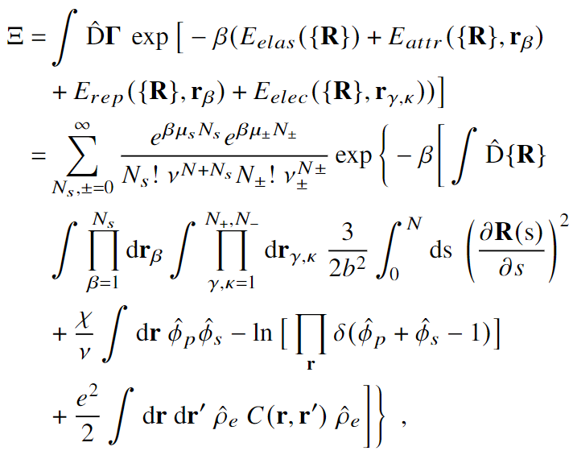

Slide 11
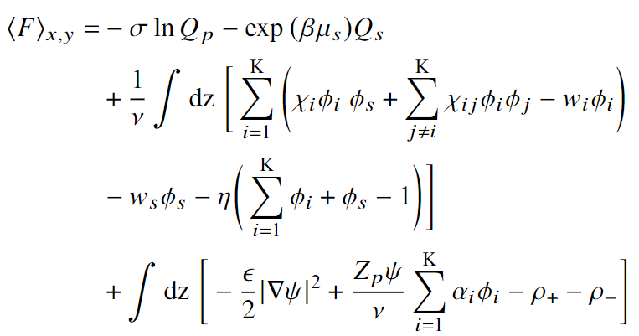




Slide 12
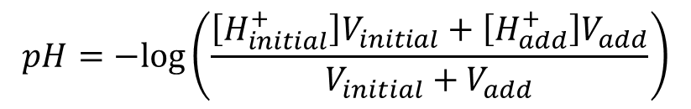
Diluting 4% Nafion dispersion with solvent (90/10 water/n-propanol pH=5.26)
Theoretical dilution:
$$pH=−log\left(\frac{\left[H_{initial}^{+}\right]V_{initial}+\left[H_{add}^{+}\right]V_{add}}{V_{initial}+V_{add}}\right)$$
90% water
10% n-propanol
Initially 4% Nafion
EW 1100

Slide 13
Sarah’s data: sonication before each pH measurement
Current data: only sonication before initial pH measurement (4% nafion)

